Slide 1


B.Tech. II Year (BELH 1004) English For Professional Purposes II Group Discussion
Type to enter

Slide 2
Content
Group Discussion (GD) - Meaning
GD- Purpose
Essential sills required for GD
Process and Tips for GD
Etiquette and Mannerism for GD
Dos and Don’ts of GD
Positive & Negative task roles in GD
Lexical Bundles used in GD
Effective Intervention
Interruption and Overlap

Slide 3
Group
A number of people, gathered together or classed together.
Discussion
derived from the Latin root ‘discutere’ means to shake or strike.
stands for an activity in which a theme/subject-matter is thoroughly , inquired or examined to reach a conclusion or decide upon a course of action.
Definition-
The term ‘Group discussion’ is used to refer to a situation in which a small number of persons meet to discuss a topic, issue, or a problem to arrive at a consensus.
The number of participants in a group discussion may range from five to ten.

Slide 4
Group Discussion: Purposes
An instrument to judge the suitability of candidates for job.
A method to develop one’s creative approaches to knowledge
A process of reflective thinking.
An effective tool to exchange information and views to solve complicated problems.
A platform for group learning
A medium to test variety of skills.

Slide 5
Essentials skills for Group Discussion
Team Spirit
Communication skills
Lateral Thinking
Flexibility
Reasoning
Leadership and Assertiveness
Presentation Skill
Time Management

Slide 6

Ability to work in a team
Group /team skills required : courteous, persuasion etc.
Collaborative skills
skills to build up team consensus.
skills to turn around people with contrary views.

Slide 7

Communication Skills
.
Being meaningful while communicating
Taking the opportunity and convey valuable points
Using appropriate voice modulation while seeking others’ special attention.
Avoiding interrupting others when they are speaking

Slide 8
Communication Skills Cont...
Should be an active listener.
Use of simple words and phrases.
Depth of vocabulary, proper grammar, correct accents, and fluency of speech

Slide 9

Lateral Thinking
Ability to view the topic or problem in a new and unusual light.
Creativity to bring a fresh string of thoughts.

Slide 10
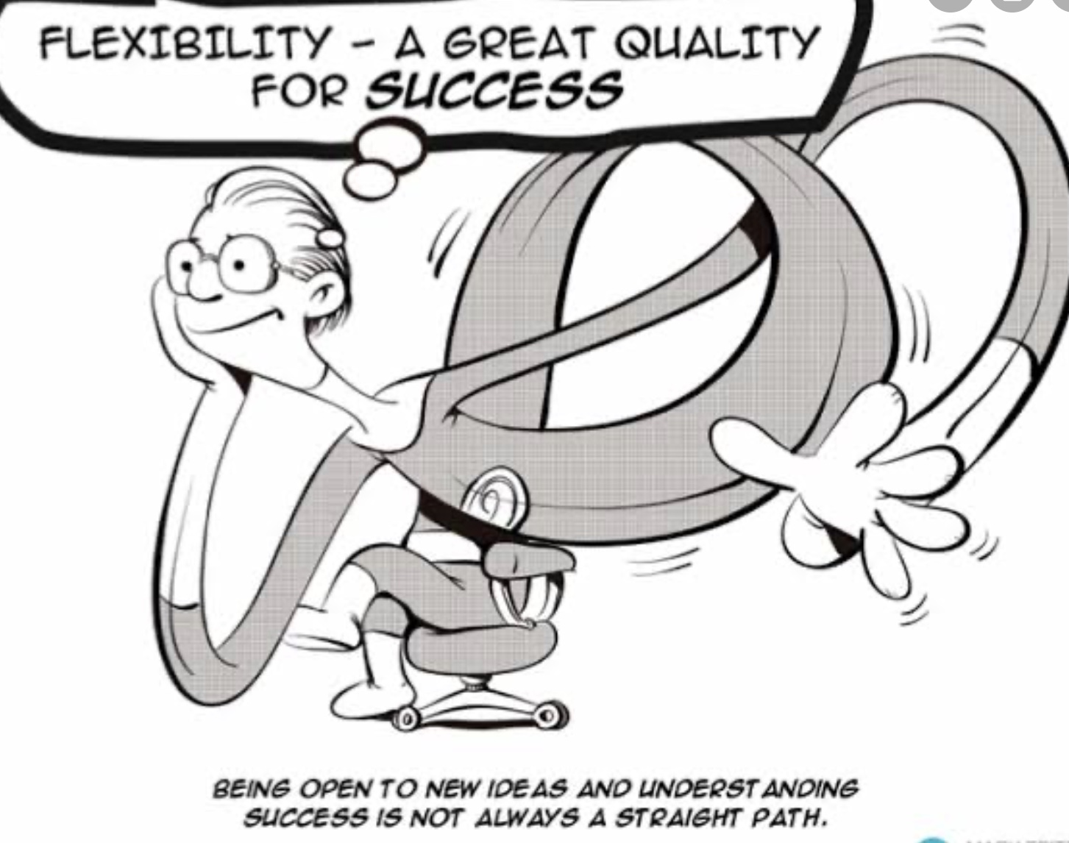
Flexibility
Organisations look for people who are flexible in their approach and adjust for the compelling reasons to do so

Slide 11

Reasoning
Comprehending the gist of the given topic
Putting forward a compelling argument
Reasoning

Slide 12

Leadership and Assertiveness
Emerge as a leader by showing leadership skills.
Demonstrate empathy toward others by listening patiently and resolving conflict, if any.
Come out of the deadlock due to polarized opinion.
Steer the discussion towards consensus.
Show assertiveness.

Slide 13
Presentation skill
effective arguments

Slide 14

Time Management
Manage the given time effectively
Respect others’ time.
Save wastage of time due to improper management.
Type to enter a caption.

Slide 15
Group Discussion- Process
The process is divided into three parts
Pre-session (Preparation phase)
During Session (Delivery phase)
Post-session (Evaluation phase)

Slide 16
Pre-session
Tips
Read newspapers, a number of books, visit websites, links of sites number of books, journals, magazines and publications
Keep reading BBC.COM guardian
Visit various websites.
Prepare facts and figures and go through current affairs.
Find out your strengths and weaknesses both at the personal and professional level and try to overcome the weaknesses.
Conduct mock GD with interested friends.

Slide 17
During Session
Tips
Speak clearly, audibly and politely.
Initiate the discussion if you’re confident of the topic, else wait for opportune moment
Content vs. language
Don’t look at the moderator
Never get sidetracked from the given topic
Organise your ideas
Demonstrate conceptual skills, interpersonal skills, critical skills, analytical skills, hard skills and soft skills throughout the session
Support and substantiate your views with facts and figures.
Be open to the ideas of others.

Slide 18
Post Session
Write down your experience.
Look back where you have done well and where you have gone wrong.
Do constructive and creative self analysis.

Slide 19
Etiquette and Mannerism for GD
Be friendly and approachable.
Encourage participation from co-participants.
Show presence of mind, humility, tranquility, tolerance, and ability to adapt and respond to impromptu situations.
It is not desirable to overplay your emotions. Stay calm.
Avoid crosstalks.
Don’t try to convince anyone forcefully

Slide 20
Do’s of Group Discussion
Be relaxed
Sit properly
Dress formally
Keep track of time
Speak at the earliest opportunity
Share time fairly
Encourage the reticent ones
Allow supporters to back your ideas
Maintain eye contact
If derailed, bring it back to right track
Show Emotional Intelligence
Connect to the ideas of others
Avoid Skirmishes and heated debates
Be alert at all times and listen attentively
Transcend personal choice
Take mental notes
Be polite

Slide 21
Don’ts of Group Discussion
Be in hurry
Dominate vocally /Physically
Lose your temper
Monopolize or hijack the discussion
Interrupt the conversation
Brag about your past experience or academic qualification
Talk loudly to draw attention
Be excessively expressive with gestures
Jump into on conclusion
Provoke any conflict
Snub the participants
Look at evaluators
Speak fast
Use slang
Start GD with decisive, firm stand
Throw all ideas at one slot

Slide 22
Positive Task Roles
Initiator
Information Provider
Procedure Facilitator
Opinion Seeker
Opinion Giver
Clarifier
Summarizer

Slide 23
Negative Roles to Avoid
Non-Participant
Attacker
Dominator
Clown

Slide 24
Lexical Bundles Used in Group Discussion
Initiating :
Good morning/ afternoon friends. My name is ......... I take the privilege of initiating the group discussion on the topic...................
Motivating
This is a wonderful topic for discussion.
The topic is quite relevant for the current scenario.
Inviting opinion
What do you think about ......Mr Sharma.
We would like to know the opinion of Mr. Sharma regarding this issue.

Slide 25
Lexical Bundles Used in Group Discussion
Giving opinion
In my opinion,
As far as I am concerned,
I would like to add..
As per my belief....
Agreeing
I totally agree with Mr Sharma,.....
Mr. Sharma made a wonderful point that.... but I would like to add.
The opinion of Mr. Sharma seems valid but we should also consider the other aspect....

Slide 26
Lexical Bundles Used in Group Discussion
Disagreeing
I beg to differ from .....on the point.....
I have certain reservations regarding.......
I have a slightly different opinion....
I would like to present a completely different aspect of the issue....
Praising
Mr. Sharma made a really wonderful point.
The opinion/suggestion of Mr. Sharma is valid and .....
Adding
I would like to add that.....
My humble submission is that...
One more aspect needs to be considered....

Slide 27
Lexical Bundles Used in Group Discussion
Seeking clarification
Can you please explain what you mean by.....
Do you mean to say........
Bringing GD on track
Let us return to the centre of our topic....
Can we now talk about......
Let us return to the issue.....
Summarizing
To sum up.........
Having considered various aspects, we can reach the conclusion that....
On the basis of this discussion, we can conclude that.....

Slide 28
Effective Intervention
Reasons for Intervention
correction of error
Controlling reckless or unruly behaviour
Adding some details to the discussion
Asking questions for clarification

Slide 29
Effective Intervention
Intervention should be very polite as it is not desirable.
Use appropriate phrases
Expressions such as-
Excuse me
Sorry to interrupt
May I say something
Can I add something
Sorry to barge in
can be used.

Slide 30
Interruptions and Overlap
During Group Discussion Speaker’s discourse has natural points for others to begin their turn. These points are called transition relevance places or TRPs. Anyone can select a free TRP to speak.
But there are interruptions also. When someone starts to talk in the middle of the speaker’s turn between TRP.
Interruptions may happen because-
the interrupter has misjudged the location of TRP.
he has anticipated what the speaker will say
he wants to cut the speaker short
it may be that he is not listening
he may understand it free-for-all situation and enters into it
This results in overlap. In an overlapped transition, the speaker talks simultaneously with the new speaker who taks the subsequent turn.

Slide 31
Idea Generation Technique
1-Brainstorming
2-SPELT-(Social, Political ,Economical. Legal, Technical)
3-VPA (View Point of A Affected Parties)
4-KWA (Key Words Analysis
5- POPBEANS (People, Object, Places, Beliefs/Behaviour, Events, Actions, Nature, Social Aspects)
6- 5Ws (Who,What’, Why, When, Where

Slide 32
Thank You

